Slide 2
Our Mission
To advocate for a quality system of child care, to advance early childhood education as a profession, and to provide services to our members.
Our Vision
To promote and support an exceptional early learning and child care system by fueling our members to be proud and excited to belong to a progressive, respected profession.

Slide 3
About MCCA
MCCA is proud to be the voice of child care in Manitoba, the largest provincial child care association in Canada, and an affiliate member of the Canadian Child Care Federation.
Our members join MCCA to become better informed about issues, to gain access to member services, and for great networking and professional development.
MCCA is entirely self funded through membership dues and professional development events.

Slide 4
Our Members in 2016
Full and part time child care centres: 501 *(73%)
Family child care providers: 348 *(82%)
Full and part time ECEs: 1,663 *(56%)
Full and part time CCAs: 1,283 *(26%)
Students: 29
Associates: 105
Total members 2016: 3955
(*Estimate of total in MB)

Slide 5
MCCA Committees
Board Operations and Development
Child Care Benefits
Conference
Editorial
Ethics Committee
Public Policy & Professionalism
Retirement Plan Advisory
School Age Support
Finance
Family Child Care
Regional Branch Chairpersons

Slide 6
core Member Services
Published 4 issues of Child Care Bridges
Updated the Market Competitive Salary Guideline Scale for 2016-2017
Added books, DVD’s, video’s, to our resource library
Increased participation in our group benefits plan with Health Source Plus to over 1000 plan members; liability insurance coverage for 400 centres and 320 licensed homes, Directors & Officers for 300 centres
9 award recipients & 19 recognized for long service to ECE
Online at www.mccahouse.org

Slide 7
RESOURCES & iNFORMATION
Human Resources
Family Child Care
Professionalism
Human Resource Management Guide for Early Learning & Child Care Programs
HR At your Service
Market Competitive Salary Guideline Scale
Job Board @mccahouse.org
Child Care & Record Keeping Calendar
Code of Ethics
Volunteer Opportunities
Privacy Policies
Let Babies Be Babies
School Age Resource Handbook

Slide 8
CCCF & Other Provincial affilates $25.00 of each MCCA Member Dues goes to the CCCF)
Association of Early Childhood Educators of Alberta
Alberta Family Child Care Association
Association of ECEs of NFLD & Labrador
Association of ECEs of Ontario
Association of ECEs of Quebec
BC Aboriginal Child Care Society
Home Child Care Association of Ontario
Yukon Child Care Association
BC Family Child Care Association
Certification Council of ECEs of Nova Scotia
Early Childhood Care and Education New Brunswick
Early Childhood Development Association of PEI
Nova Scotia Child Care Association
Early Childhood Educators of BC
Saskatchewan Early Childhood Association

Slide 9
6 Regional Branches MCCA Provides funding support to Branches
Three workshops and Week of the ECE Paint Nite fun in Central Region
Two workshops held in Interlake Region
Two workshops and Week of the ECE bowling night held in Parklands Region
Two workshops held in Eastman.
Spring conference with 6 workshops, fall directors conference in South Central Region
Over 100 in attendance at events held in Thompson Region
Westman Region worked to increase professional development at spring & fall events and improve communications with members

Slide 10
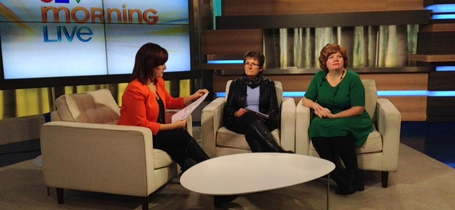
Advocating for Child Care as a service and as a profession
Participated on the Commission on Early Learning and Child Care
Meetings with the New Minister of Families & NDP Critic
submitted recommendations to new Provincial Government
Pre-budget Submission to Minister of Finance
Submission to House of Commons Standing Committee on Finance
Pre-budget consultation presentation
Regular meetings with Early Learning and Child Care program
Media events to keep child care in the news

Slide 11
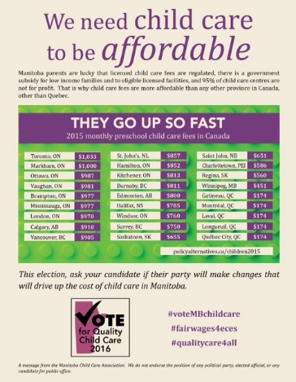
Educating the public

Slide 12
Provincial Election Forum on Child Care
NDP & Liberal & Conservative Reps
Moderated by Richard Cloutier
Almost a Full House!

Slide 13
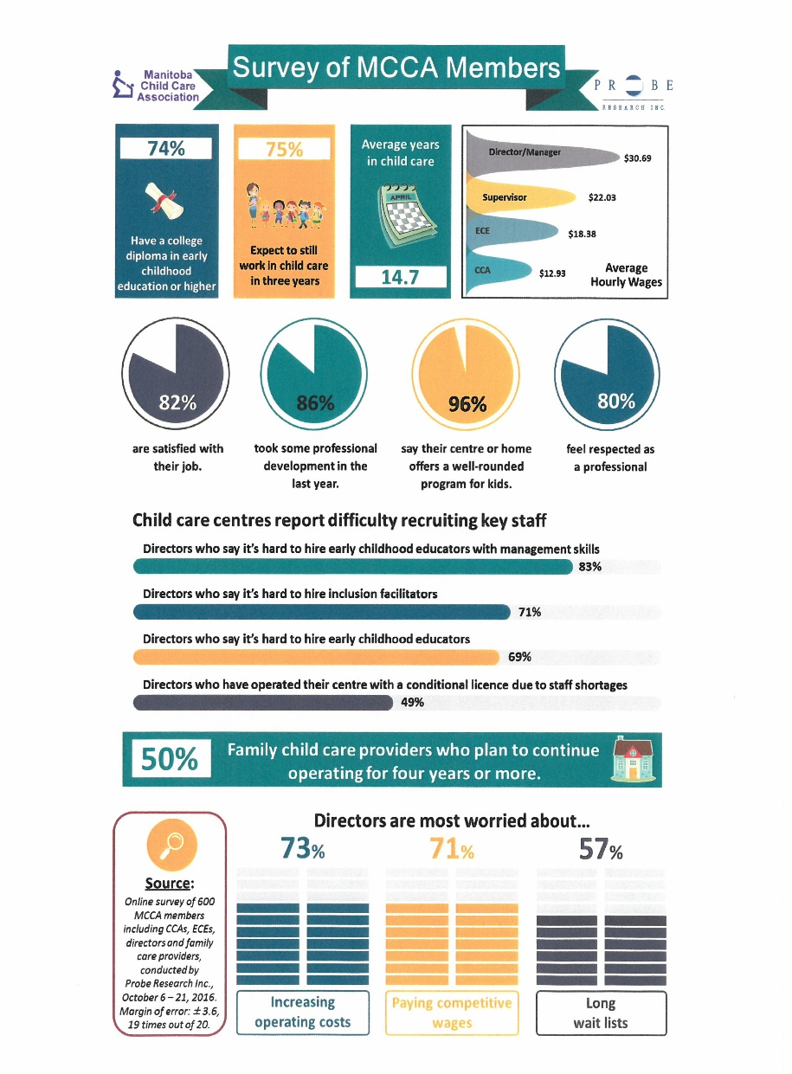
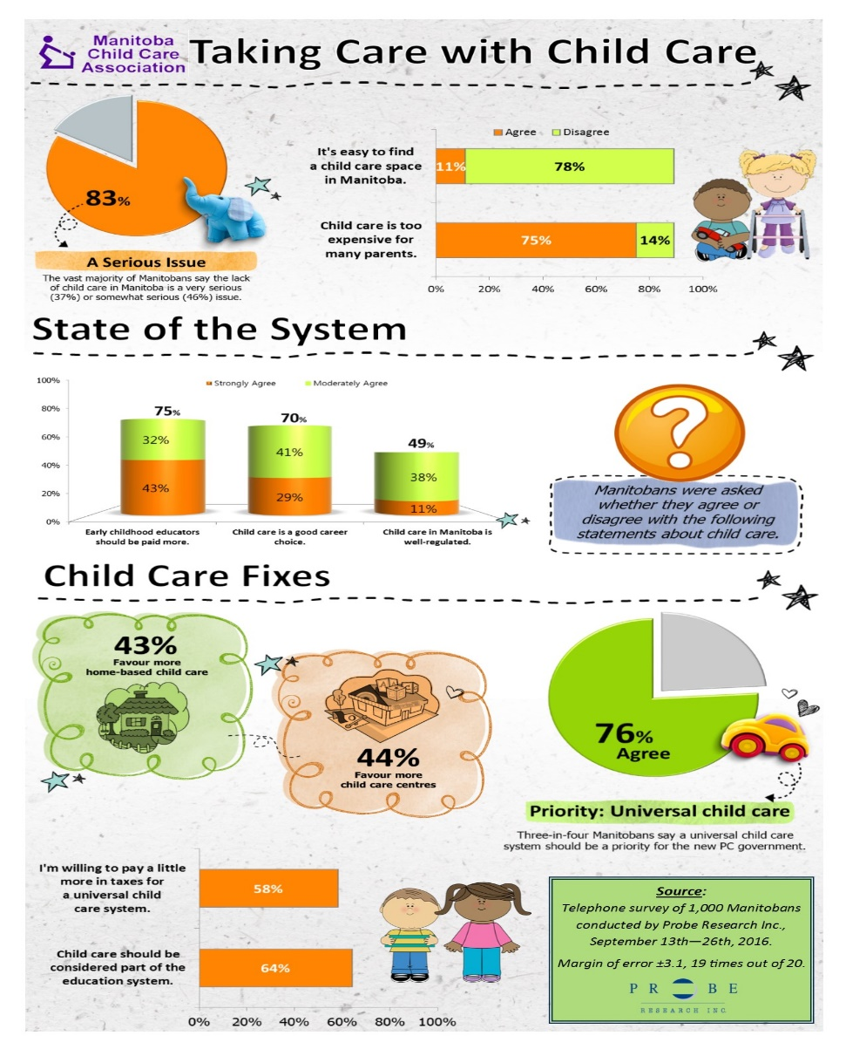
MCCA/Probe Research project

Slide 14
Professional Development 2016

Slide 15
1073 participants at the Winter workshops

Slide 16
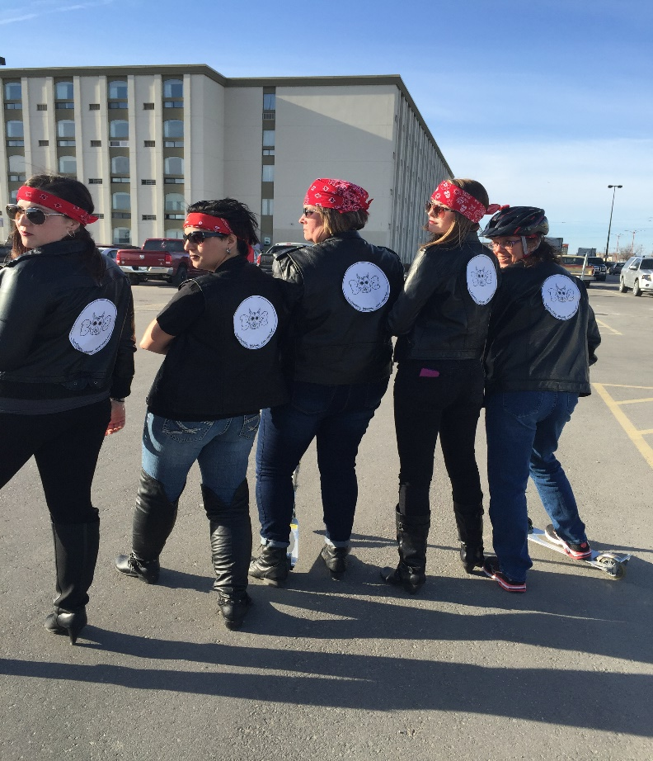
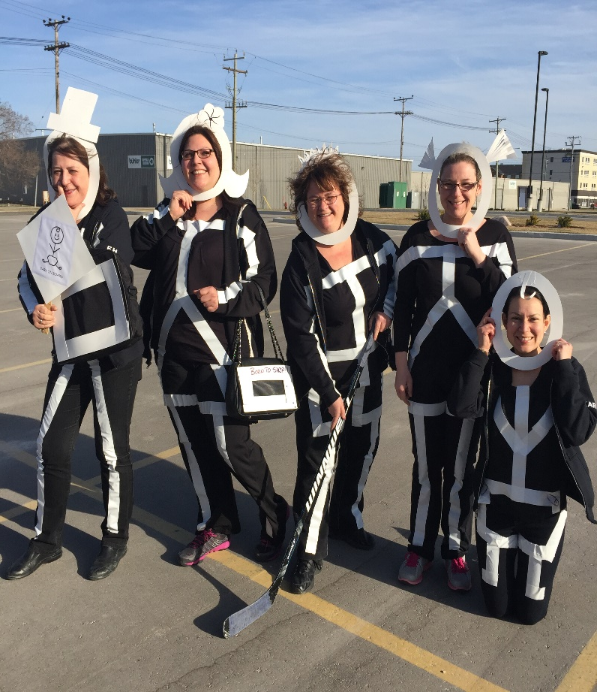
Celebrating 25th Annual Week of the ECE!

Slide 17
Be Inspired, Be Incredible Conference 2016
Conference committee
Delegates from near and far
Minister Fielding & Marg
Having some fun
1,043 Registrations
Bringing Greetings from the PRovince

Slide 18
Conference awards banquet Recognizing outstanding memberS!
Leader of the Year
Exceptional FCCP
All REcipients
Cassandra acland
Susan Koppel
Dr. Gretta Brown, Volunteer, Educaring, ECE, FCCP

Slide 19
1328 participants at the fall workshops

Slide 20
98 Delegates at the 17th annual Directors Conference
First Time Delegates
Work Hard Play Hard
Panel of Experts

Slide 21
22 Personalized Professional Development Events
OnSite
Customized
Anywhere
Treasure Keepers
Stars of Promise
Village Child Care
Ryerson School Age
East TransconA B&A
Military Family Resource Centre
Horizons Childrens Centre
Happy Feet Early Learning
YMCA/YWCA
K.I.D.S Inc
Dawn & Dust Before & After
Garden Grove Child Care
Crestview Park Day Nursery
Taking Charge! Taking Care
Wawanesa Wee Care
Gillis Play & Learn
Eastman Directors
Island Lake Tribal Council
Westman Region
J.A. Cuddy Child Care Centre

Slide 22
Training For New Ethics Guides 2016
14 New guides!
Ethics Trainers
Guides Presenting to Guides

Slide 23
Pedagogical leadership
Pedagogical Leaders
Pedagogical Gathering
Post institute
30 Leaders training with Deb Curtis & Brigitte iNsull
60 in attendance

Slide 24
Coming in 2017
Updated Human Resource Management Guide for Early Learning & Child Care Programs, with a new chapter on board governance
MCCA Board of Directors & Regional Branch Chairpersons Strategic planning, June 2017
Pedagogical Institute, October 2017
Exploring the feasibility of an online board training workshop

Slide 25
Thanks to Our Board of Directors and Volunteers on all our committees….

Slide 26
Our Regional Branch Chairpersons 2016, and the Regional branch board members….

Slide 27
MCCA Staff and allan

Slide 28
Questions?

