Slide 1
40Th Annual General Meeting
Thursday, May 21, 2015

Slide 2
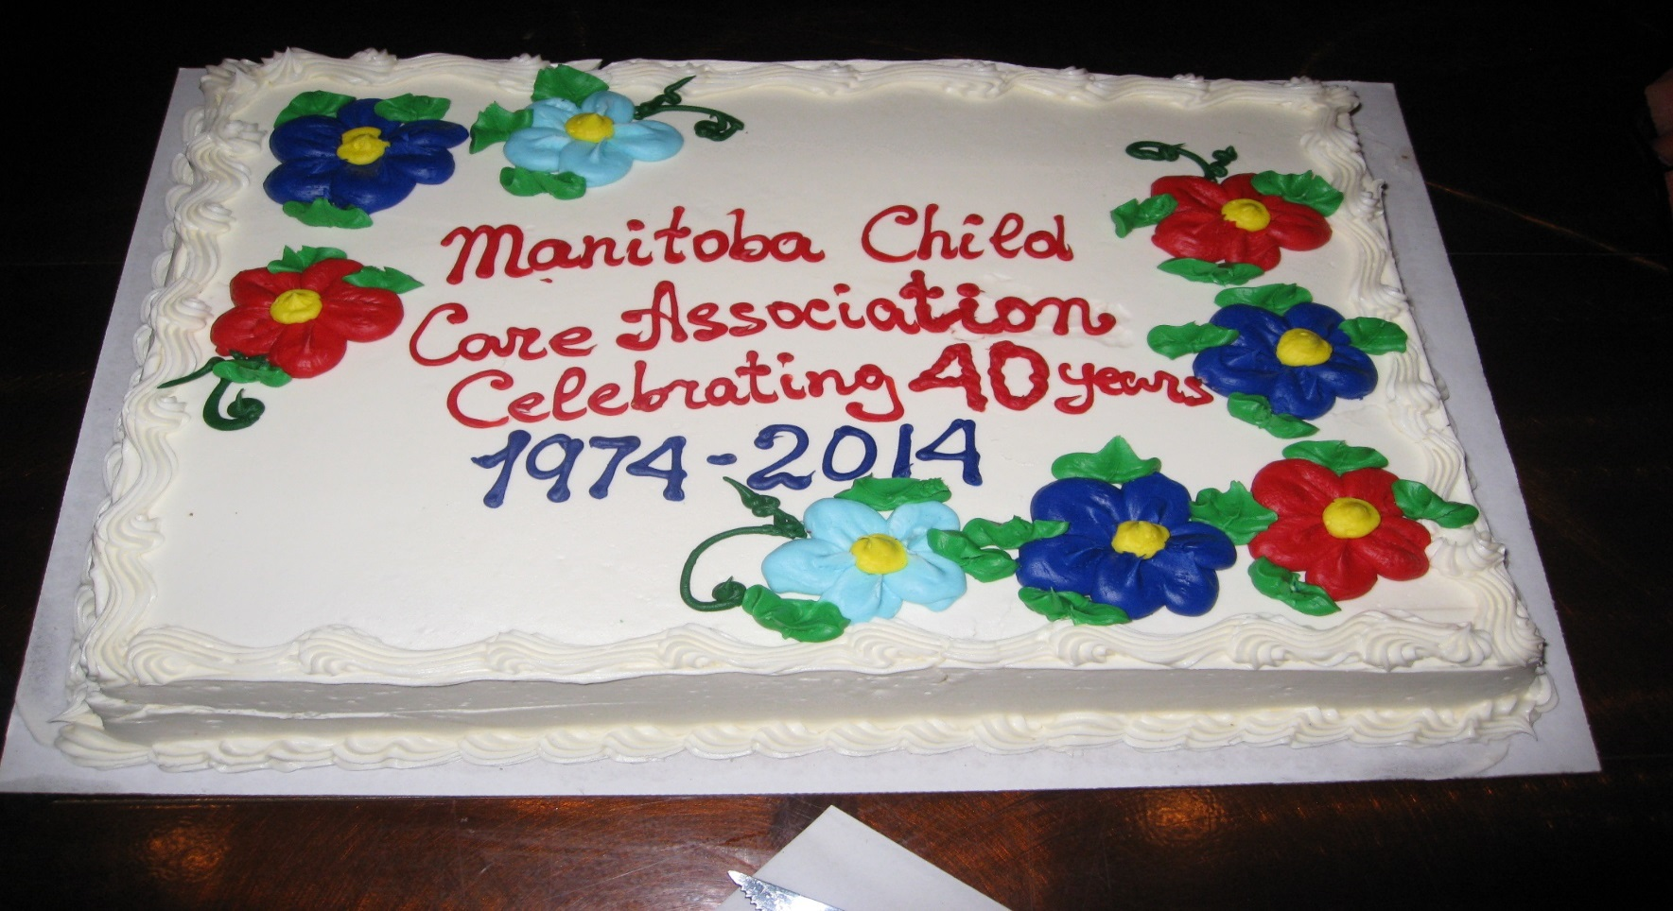
Proud to celebrate 40 years of leadership, advocacy and member services!

Slide 3
Our Mission
To advocate for a quality system of child care, to advance early childhood education as a profession, and to provide services to our members.
Our Vision
To promote and support an exceptional early learning and child care system by fueling our members to be proud and excited to belong to a progressive, respected profession.

Slide 4
Our Members in 2014
Full and part time child care centres: 490 *(74%)
Family child care providers: 348 *(82%)
Full and part time ECEs: 1,648 *(59%)
Full and part time CCAs: 1,326 *(33%)
Students: 34
Associates: 123
TOTAL MEMBERS: 3969
(*Estimate of total in MB)

Slide 5
Member Services in 2014
Published 4 issues of Child Care Bridges
Recognized the achievements & milestones of 37 members
Published the MCSGS 2014-2015
Added new resources to our library
Achieved cost containment for all our insurance programs
Ensured our SMPPP and group RRSP comply with CAP guidelines
Celebrated the 23rd Annual Week of the ECE
Supported the work of 10 committees & 6 regional branches

Slide 6
Professional Development in 2014
37th Annual Provincial Conference Wisdom Begins with Wonder, attended by 1162 delegates
Winter workshops attended by 1177 participants
15th Annual Directors conference, Spirit of the Leader”, attended by 118 administrators
Fall workshops attended by 1350 participants
Lunch & Learn sessions for administrators and 11 personalized events

Slide 7
Advocating for Quality in 2014
Provincial Pre-Budget Consultations 2014
Meetings with the Family Services & Education Ministers and opposition members
Developed recommendations to Government
Meetings with Manitoba Early Learning and Child Care
On the steering committee for ChildCare 2020
Represented on the Recruitment & Retention Roundtable
Represented on the Commission on ELCC

Slide 8
New Projects in 2014
Completed the upgrade and redesign of our website
Completed the upgrade and revisions to our Human Resource Management Guide for Early Learning and Child Care Programs
Modernized our group benefits plan by adding new options and introduced a retiree plan
Introduced a new member managed software: Your Membership
Made enhancements to our liability insurance plan

Slide 9
Community Relationships in 2014
Provincial Health Child Advisory Committee
Educaring Committee
Manitoba School Boards Association
Manitoba Association of School Superintendents
Manitoba Early Learning & Child Care
Healthy Child Manitoba
RRC ECE Advisory Committee
Canadian Child Care Federation Member Council
Early Childhood Education Program Approval Committee
Community Living Manitoba Inclusion Committee
Provincial Council of Women
Provincial Nutrition Strategy

Slide 10
In 2015 We Will…..
Continue to lead, advocate, and provide a wide range of member services.
Encourage more members to use the membership managed software (YM)
Update our MCSGS 2015-2016
Work with the Commission on Early Learning and Child Care
Prepare resources for the upcoming federal and provincial elections
Hold the first Pedagogical Leader Institute, Oct 15 - 17

Slide 11
Thank you to our board of directors!

Slide 12
And to our staff!

Slide 13
And of course…our members!

Slide 14
Remember - MCCA Rocks!

Slide 15
Questions?

